Slide 1
Game Theory
Linear Algebra Applications
Aaron Franklin, Dieonna George and Chris Henson

Slide 2
Linear Algebra matrix computations can be used as a powerful tool to solve Game Theory problems

Slide 3
Key Terms
Player-Person or object that competes with other persons or objects and has a specific set of choices they can make.
Game-Problem or situation in which the choices made by one player can affect all players involved.
Risk-How much the player can lose if they make a negative choice.
Reward-How much the player can gain if they make a positive choice.

Slide 4
Key Concept #1
The Nash Equilibrium
Attempts to predict what choices will be made if multiple players are making decisions simultaneously. Its main objective is to maximize a player’s payoff while reducing an opponent’s. This makes the resulting sum of player’s choices equal to zero.
Mathematically, we have two players A and B, each with their own choices A = n and B = m. We also have a function P, which can be calculated as A ✕ B. The resulting matrix is known as the “Payoff Matrix”.
Zero Sum Game: A type of Nash Equilibrium in which a player’s risks or rewards are diametrically opposed to their opponent’s. This is typically seen in two-player games.

Slide 5
Key Concept #2
Reduction by Dominance
Check whether a row or column in the matrix is dominated by (i.e. larger than) another row or column in the matrix and remove the dominated row or column. Repeat this until there are no dominated rows or columns left.
Dominance is defined as a choice having either equal or even better rewards than the next best choice. It eliminates other choices in order to present the best choice to a player so they can gain the most amount of reward.
Always start with the first row. Each number in a row must be greater than (or less than) other numbers in opposing rows. Otherwise, both rows and columns dominate each other

Slide 6
Zero Sum Game
Rocks, Papers, Scissors
Rock, Paper, Scissors is a simple example of a Zero Sum Game.
A Payoff Matrix can be determined the same way as the Prisoner’s Dilemma’s payoff, but this time produces a more symmetrical result.
For example, we count the scores of two players over multiple games.
For every win, a player adds one point, for every loss, a player subtracts a point, and for every tie neither adds nor subtracts a point from the score.

Slide 7
The Payoff Matrix would look like this:
Is the Game Symmetrical?
n = m = 3
P1 = P2 = [Rock, Paper, Scissors]
P1 ✕ P2 = [0 1 −1][−1 0 1][1 −1 0]
This matrix is akin to a skew-symmetric matrix, which means that the game itself is symmetrical. If one player wins a point, the other player loses a point. If both players tie, then both players neither receive nor lose a point. This is the essence of a Zero Sum Game: for every positive choice a player makes toward a reward another player makes a negative choice that diametrically opposes it.

Slide 8
Application #1
The Prisoner’s Dilemma
The police arrest two criminals, Rob and Bill, for selling drugs. The cases are open and shut, and both will go to jail for two years. They have never met, have no connections to each other, and consequently have no loyalties to each other. However, the police notice that they look like two criminals who had committed a bank robbery together two weeks earlier and want to press for a confession from the prisoners. They offer both a deal:
1. If both deny they committed the bank robbery, they will go to jail for two years for selling drugs, just like they were supposed to.
2. If Rob confesses to the bank robbery but Bill does not, then Rob will only go to jail for one year while Bill will go to jail for ten years.
3. Likewise, if Bill confesses to the bank robbery but Rob does not, then Bill will only go to jail for one year while Rob goes away for ten years.
4. If both confess to the bank robbery, then both Rob and Bill will go to jail for three years.
Which is the mostly likely choice that Rob and Bill will make?

Slide 9
Prisoner’s Dilemma
The Math
Rob=Y, Bill=X
Each number represents the
amount of years either Rob
or Bill will go away for.
Most Rational Choice:
Deny the Robbery(least risk)
Most Beneficial Choice:
Confess on the chance that the other does not
because they would only get less time in jail.
 | Confess | Deny
Confess | 3,3 | 1,10
Deny | 10,1 | 2,2

Slide 10
Confess or Deny
Calculate the Payoff via Nash Equilibrium
n=m=2
Rob=Bill={Confess, Deny}
Representation: Confess=“0”; Deny=“1”
This produces two dimensional vectors for each of the possible choices.
Now we calculate the cross product of each of the choices, or simply find the determinant of the matrix created since the matrix is two dimensional.

Slide 11
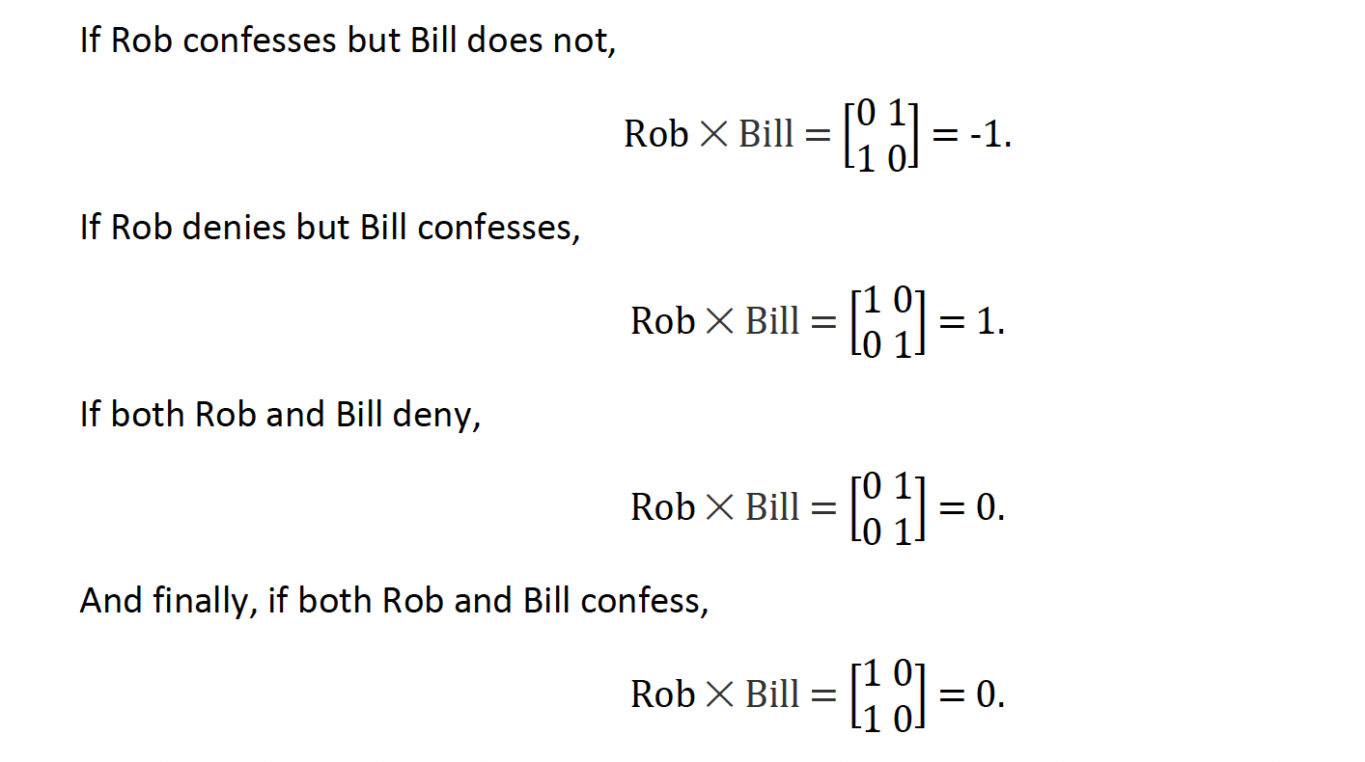

Slide 12
Application #2
Football Strategy
Different from the Nash Equilibrium and Zero Sum Games is the theory of Dominance, or more specifically Reduction by Dominance.
This method uses dominant rows or columns in a Payoff Matrix to determine the highest reward out of different choices a player can make.
This gets straight to the point, and most of the time is used to find absolute rewards in certain situations.
For example, football teams use this method to decide which play to use against another team during a game to improve their chances of winning.

Slide 13
Football Strategies
Theory of Dominance aka Reduction by Dominance
This method uses dominant rows or columns in a payoff matrix to determine the highest reward out of different choices a player can make.
Expedites the process of determining the optimal reward in each specific situation.
Football teams use this method to decide which play to use against another team during a game to improve their chances of winning.

Slide 14
The Math
Information gathered is arranged in five by three matrix
Matrix that will utilize row reduction in order to determine the optimal play.

Slide 15
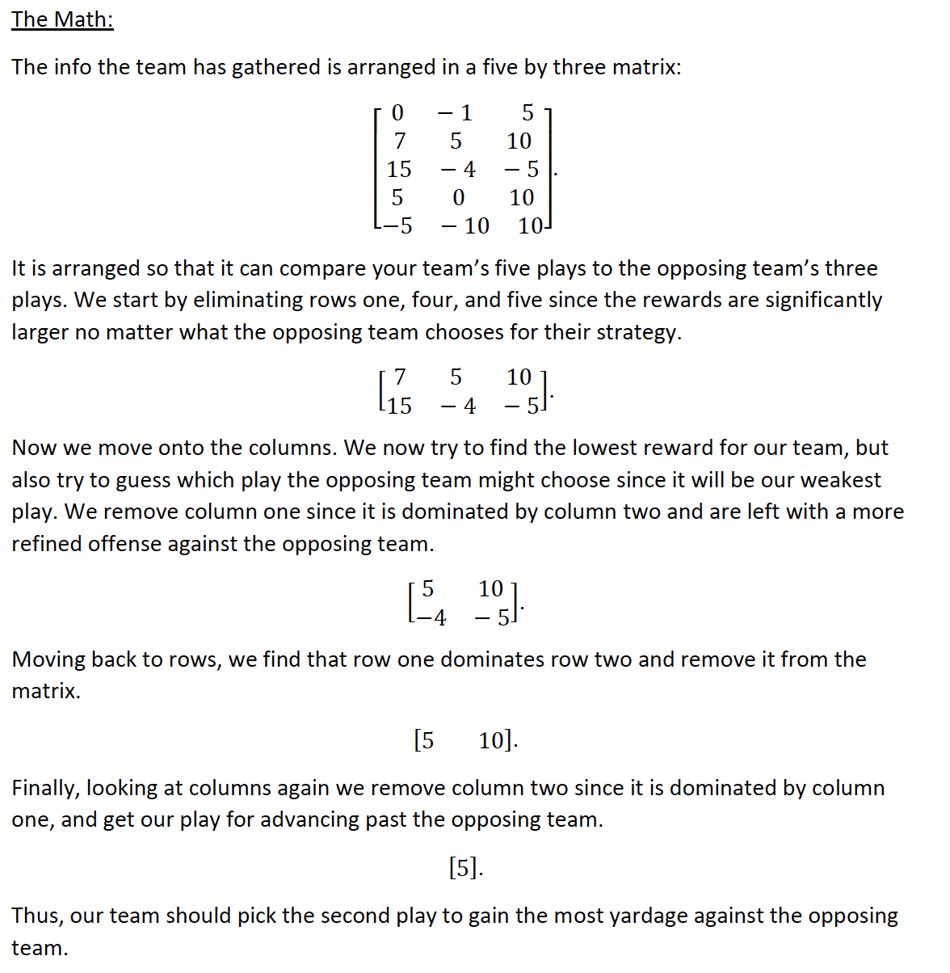
The Math
Matrix that will utilize row reduction in order to determine the optimal play.

Slide 16
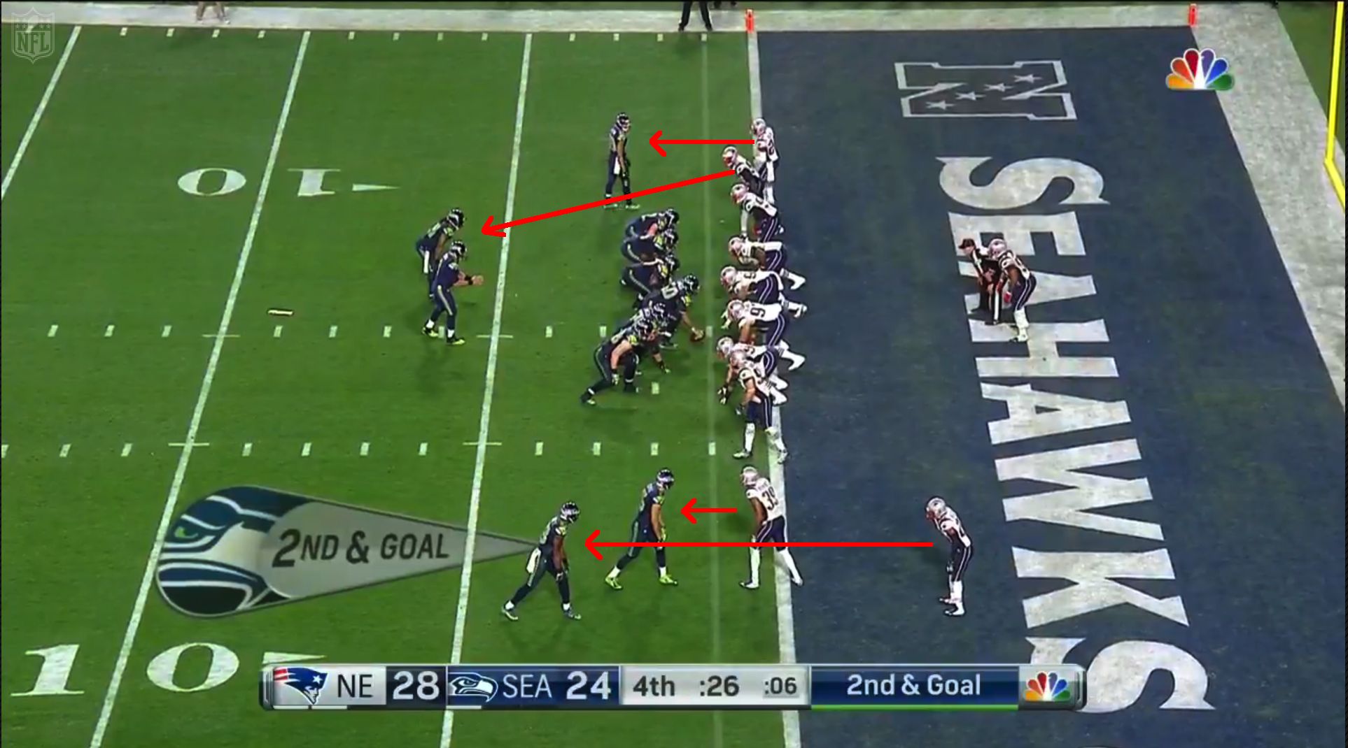

Slide 17
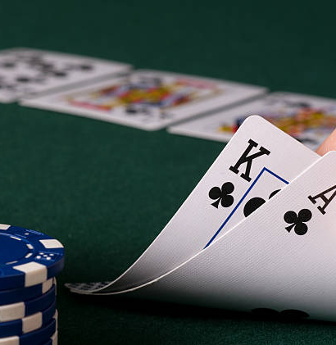
Application #3
Texas Hold’em Poker
Visualization of Hold’em Hands
Creating a matrix of Probabilities
Big Stacks

Slide 18
Before the Flop
Matrice Application to the Pre-Flop Hand in Texas’ Hold ‘em
Harvard’s Center for Astrophysics, has put together a series of matrices, allowing you to better figure out when you should hold ’em and when you should fold ’em, even before the first flop.
What makes Texas Hold ‘Em such a fascinating game from a probability perspective is that, with over 1.3 trillion possible hands between just two players, the only way to visualize the odds of any given hand winning is as a 4-D hypercube.

Slide 19
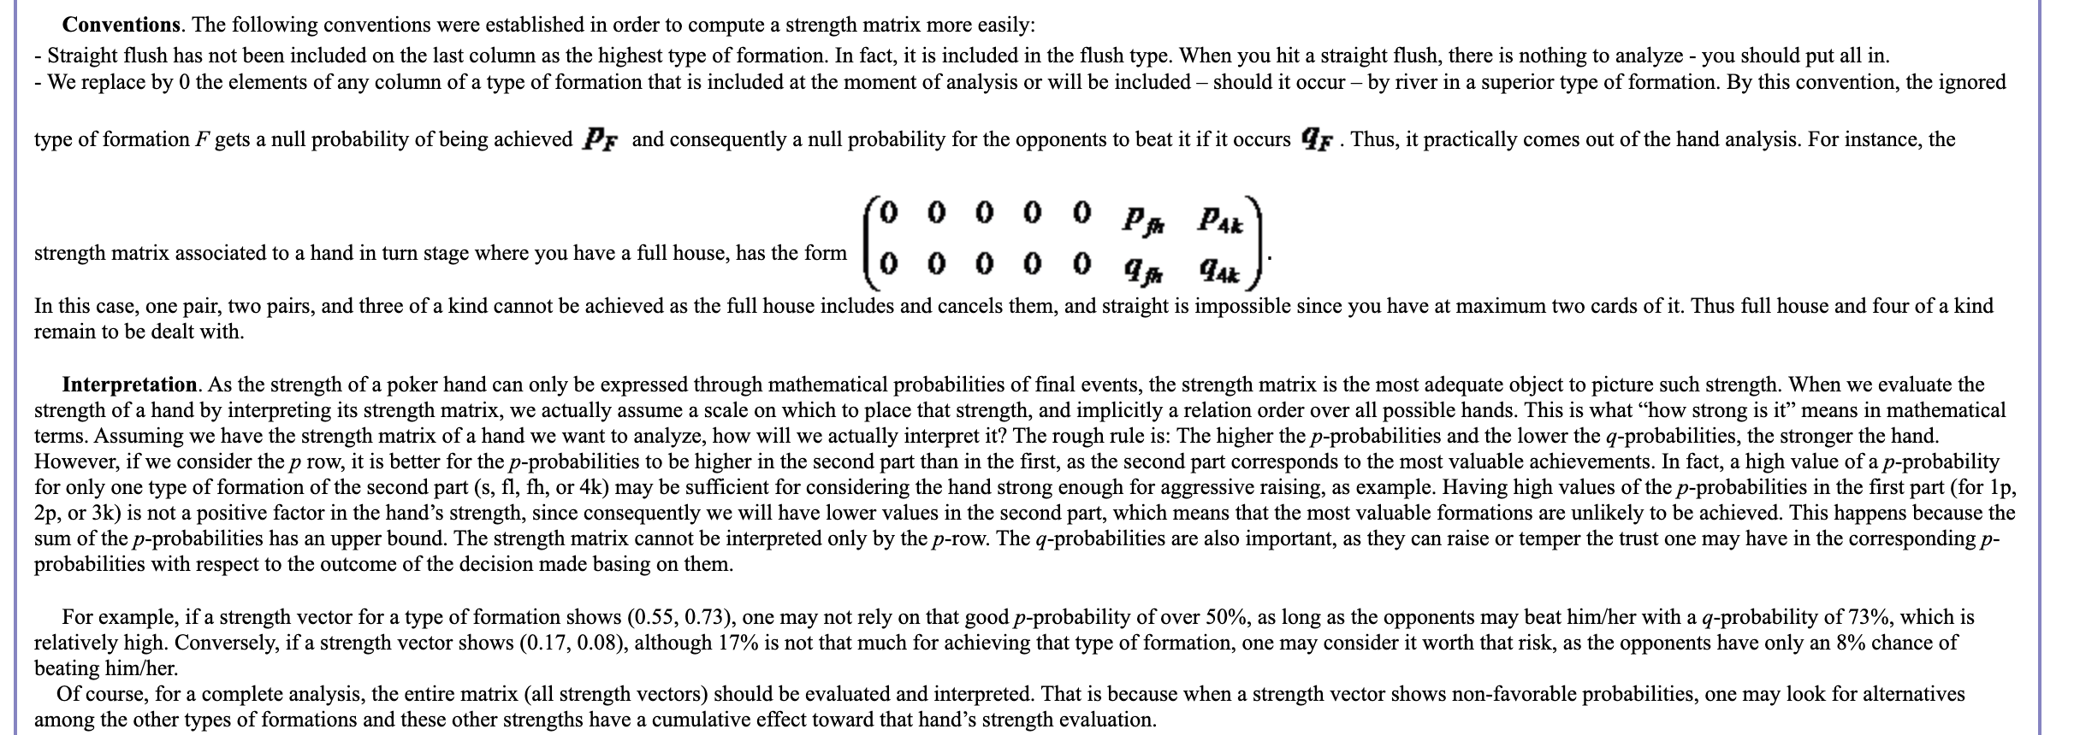
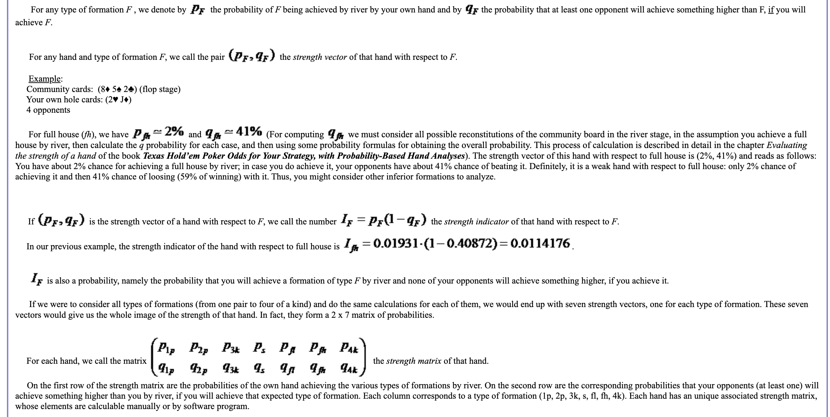
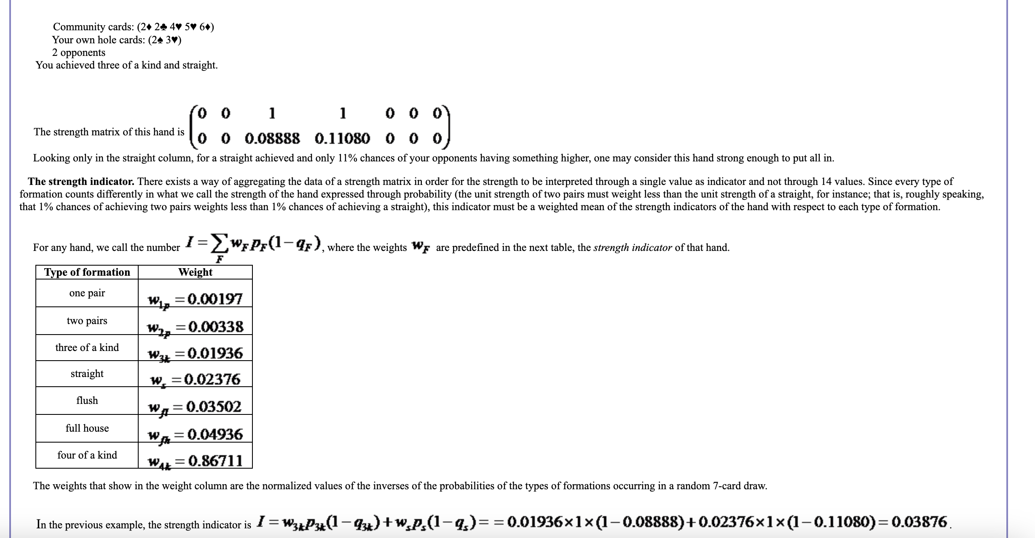

Slide 20
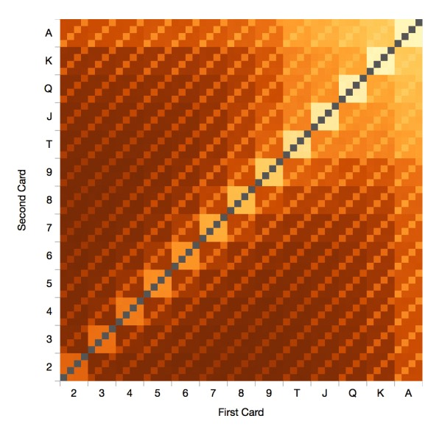
Hand Frequencies
cuts this hypercube into 2-D matrices that show hand frequencies, average hand strength, weighted strength, and more.
We can compute a more accurate summary of hand strength if we know how often real opponents tend to play every hand. Luckily, such databases exist.
This third panel shows the actual frequency with which each hand is played, based on mining several million online poker hands. The brightest squares are played most often.

Slide 21
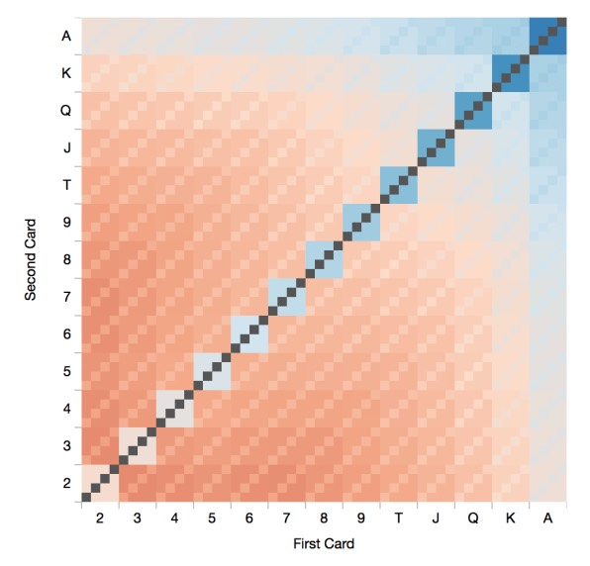
Weighted Hand Strength
With the hand frequency data above, we can compute a more accurate average hand strength. We repeat the same process for averaging each hand over all opponent hands, but we weight the average by the frequency of each opponent hand. The colors in this panel correspond to the profitiability of each hand, when playing against a "typical" opponent who folds weak hands.

Slide 22
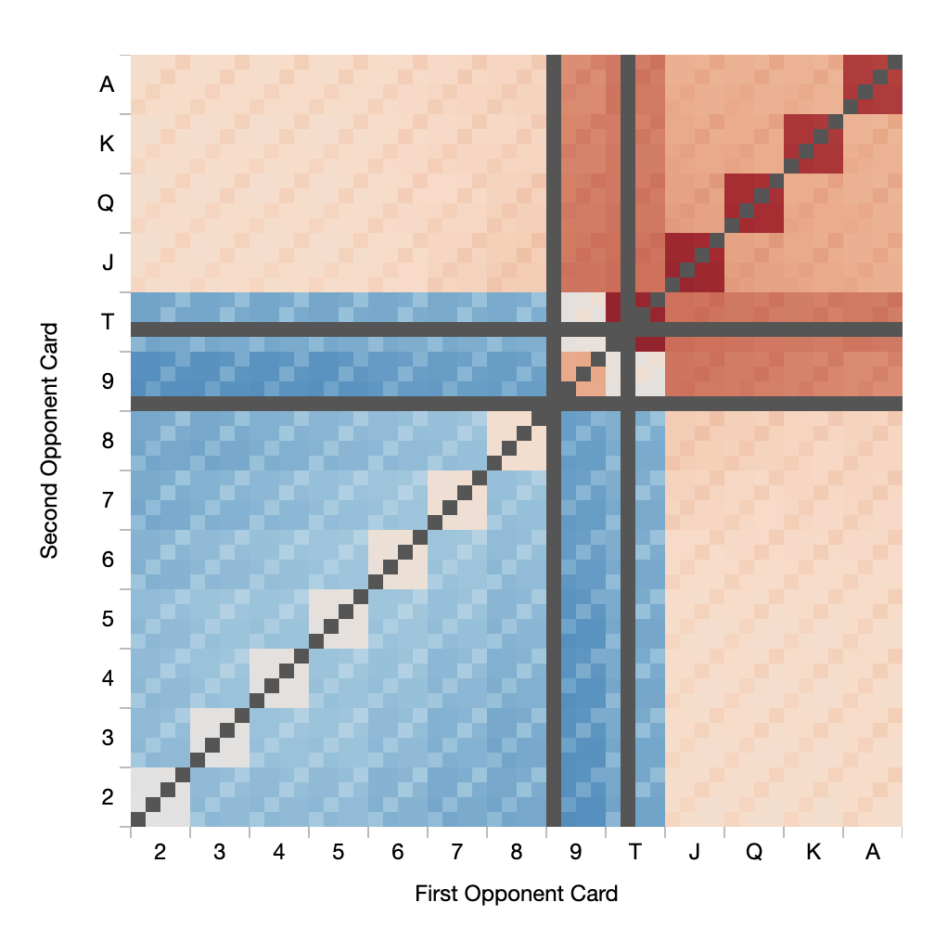
Navigating the Grid
Opponent pair cards are organized along the main diagonal, in a band of 4x4 boxes. Opponent suited cards lie along other diagonals. The dark squares correspond to impossible hands, where a card is duplicated.
If you are holding a pair, an opponent holding any higher pair has essentially the same advantage over you, regardless of the rank of the pair.
In fact, compared to (say) a pair of 6s, a pair of 7s is slightly better than a pair of Aces.
While a pair of Aces is the strongest hand averaged over all opponent hands, the single strongest heads-up face-off is a pair of Kings vs a K+2 offsuit.

Slide 23
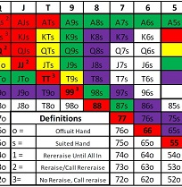
Poker Algorithm
Final Product of Research is a Matrix for Texas Hold’em Poker.

Slide 24
Poker Player Archetypes
Two Dimensions
Loose Tight-measure of how many starting hands are played before the flop.
Aggressive Passive-how often you initiate action by raising and re-raising rather than responding to action by calling or folding.
Aggressive players win a higher percentage of hands played than do passive players.

Slide 25
Statistical Analysis
Translation to Real World
25 hands per hour for 10 hours [2.5 hands per hour]
this equates to 250 hands.
how many will he fold pre-flop. Between 80% and 90% for a 9 or 10 handed game early in a tournament.
Pro will see a flop with cards around 25 to 50 times in a long 10 hour day.
You may go to the river only 5 or 6 times in a day

Slide 26
Linear Algebra translates to Winning Poker
Playing to Win the Hand vs. Playing to Bust your Opponent.
Strategy is Independent of Archetype
Loose Tight vs. Aggressive Passive
J and 10 suited
Small Pair(4,4)
Suited One Gappers (7, 9),(6,8)
Ace and 7 suited.
Pair of 10’s

Slide 27
Swimming with the Sharks
Are you the Fish or the Bunny?
Professional players are interested in how much money we win, not the proportion of hands we win.
Maximizing money can be done by many strategies ie. playing lots of small pots; playing only a few big pots; losing small pots, but winning big pots.
Linear Algebra is the key to winning poker at the professional level.

Slide 28

Art Installation
Linear Algebra is the basis for this Art Installation.
Real Time Data from the Stock Market.
Bitforms/Dan Canogar

